Slide 1

PLAYER ANALYSIS USING SAS
Notes:
Today, we will be discussing a Company that focuses on selling packaged products that represent a theme of different cultures that are in turn representative of countries around the world – Try The World!

Slide 2
Agenda
Introduction
Objectives
Descriptive Analytics
Dream 11 – Using Linear Regression
Decision Tree
Decision Tree v/s Logistics Regression
Applications
Conclusions
Q&A

Slide 3

Fifa 2017
International governing body for association football
Headquartered in Switzerland
Worldwide popular sport
211 national associations
11 players in a team
90 minutes games

Slide 4
OBJECTIVES
Identifying young potential players
Player age groups
Preferred foot
Identifying players with high stamina having high speed and acceleration
Identifying potential youth players
Predicting best 11 players for Dream 11 team
Decision tree – Work Rate
Decision tree v/s Logistics Regression

Slide 5
introduction to data
Data set ‘FIFA 2017’ has been derived from Kaggle
17000+ players all over world
More than 16 player attributes
We simplified the data into 4 positions: ‘Attackers’, ‘Midfielders’, ‘Defenders’, ‘Goal Keeper’
Not considering Substitutes and Reserves players

Slide 6
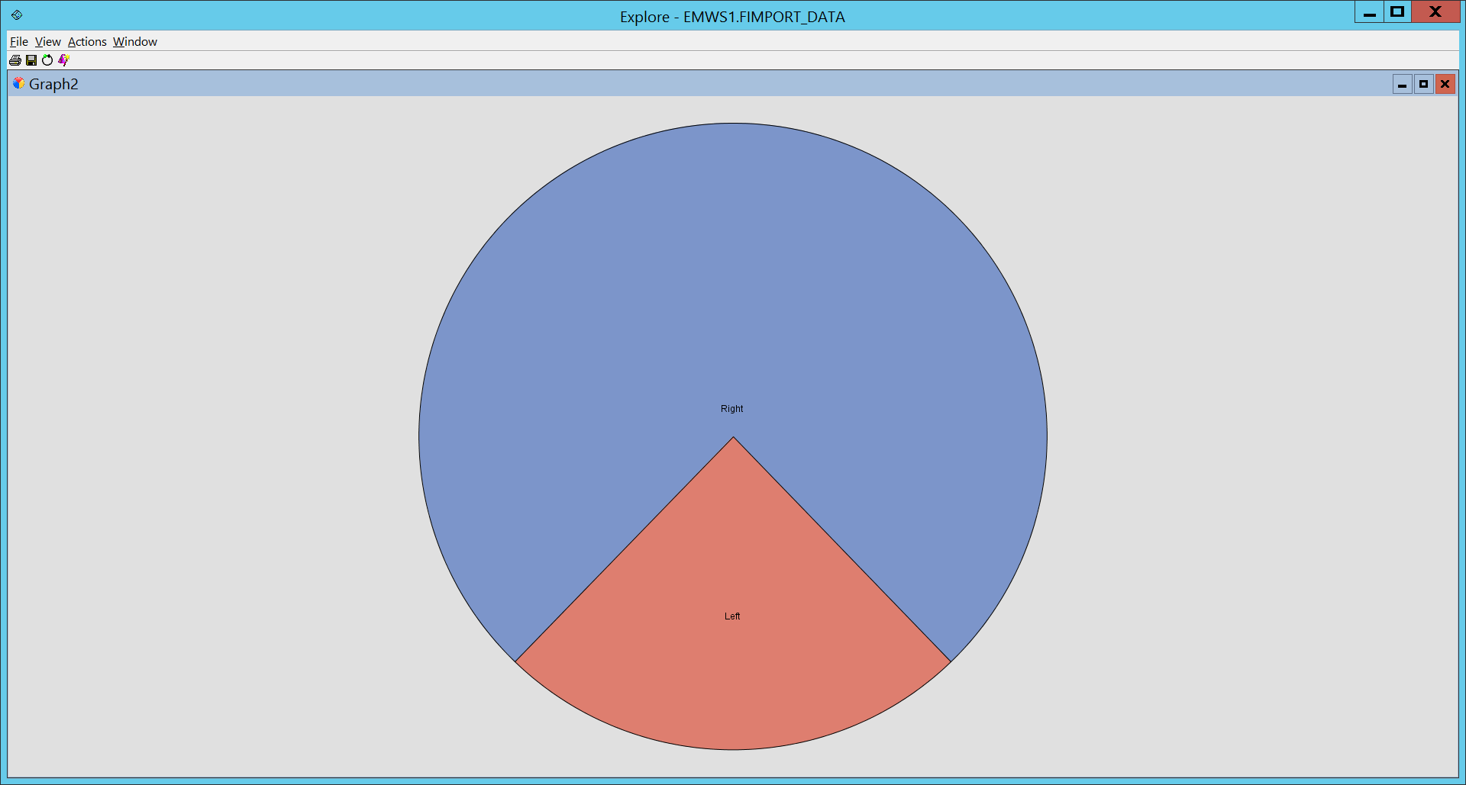
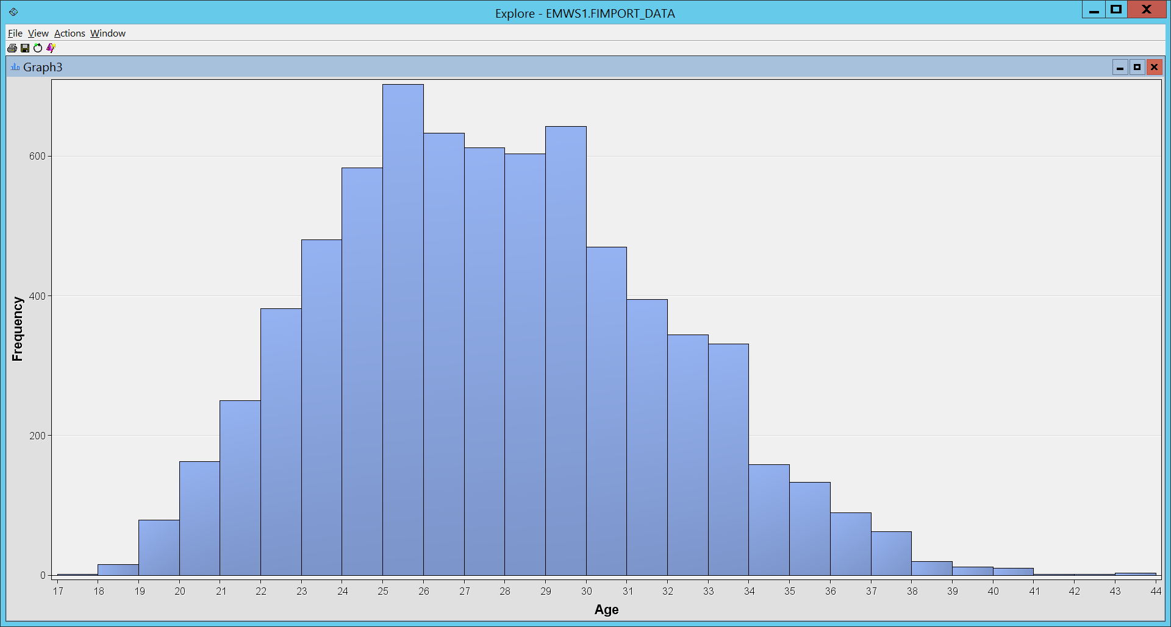
Descriptive statistics
-

Slide 7
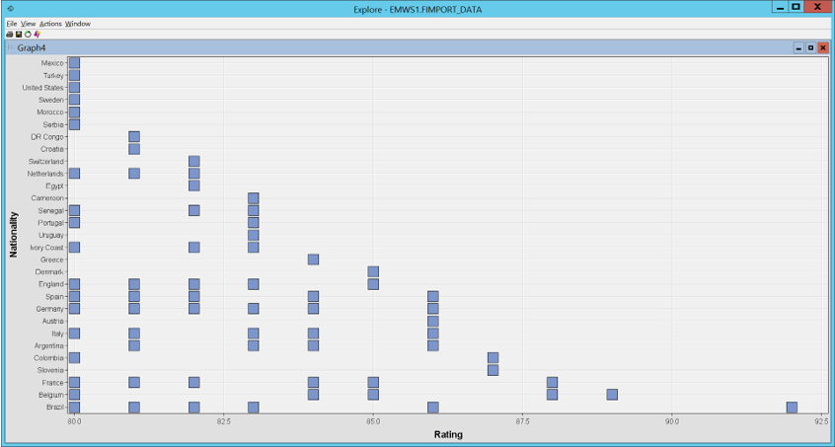
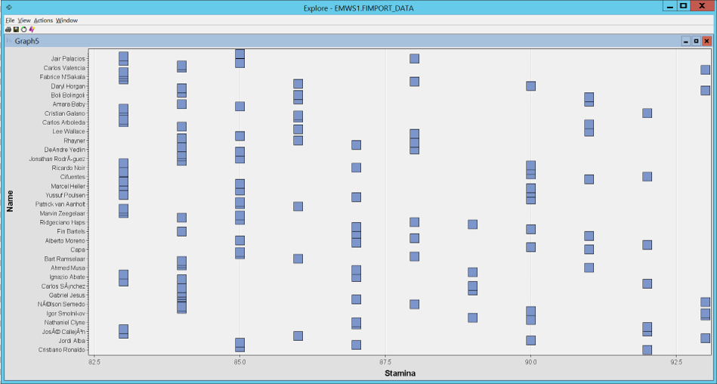
Descriptive statistics
-

Slide 8
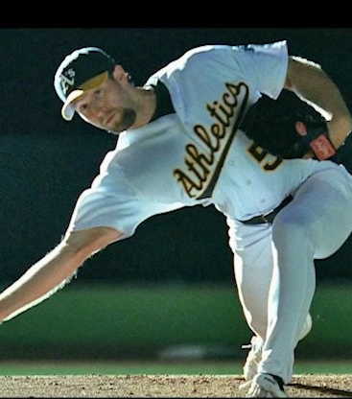

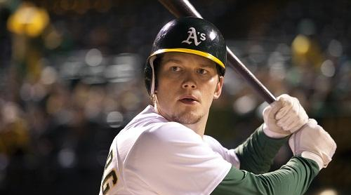
Moneyball movie
Based on real life story of Chicago Athletics team
Player analysis
Skill analysis
How statistics is playing an important role in sports world today
Our project is inspired from this movie

Slide 9



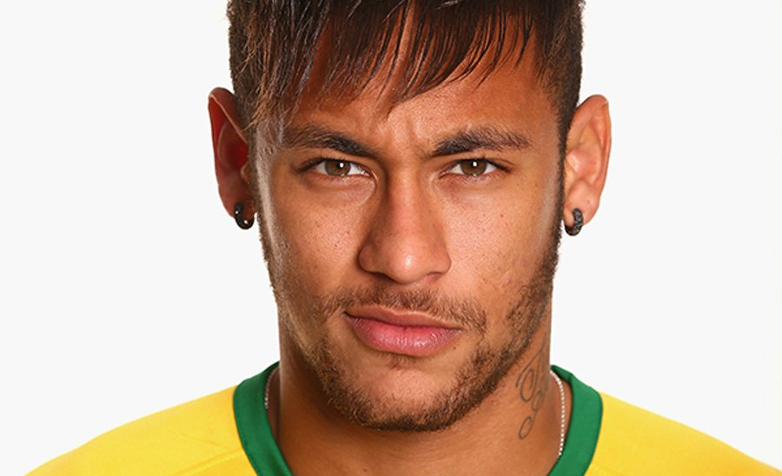
Finding dream 11

Slide 10

But how?
17000+ players
16+ player attributes
Playing positions?
Skills?
Physique?

Slide 11
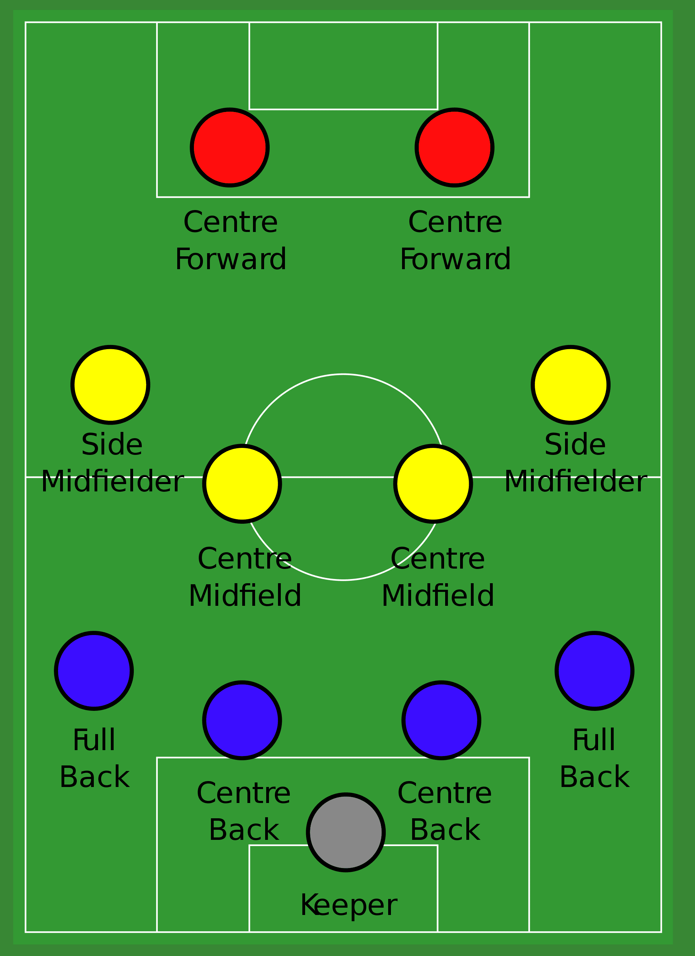
Considerations
Classified player positions into 4 groups – Attackers, Midfielders, Defenders & Goal Keeper
Not considering substitutes & reserves
Aiming at 4-4-2 formation
So we need 2 – Attackers 4 – Midfielders 4 – Defenders 1 – Goal Keeper
Considering attributes based on player positions

Slide 12
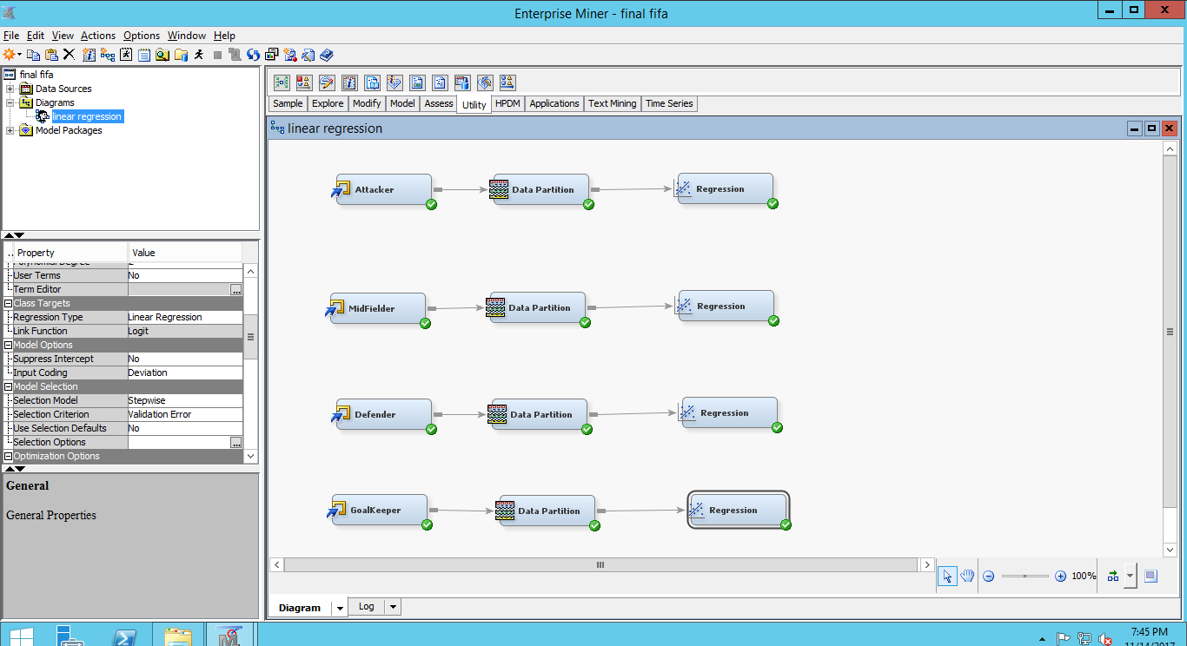

Slide 13
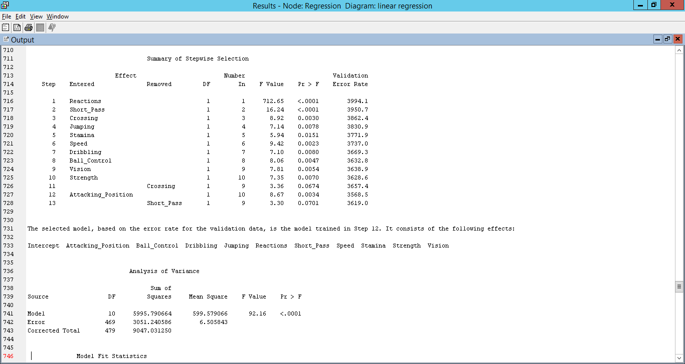
Linear regression – Attackers
- Applied set wise linear regression
-Following variables were selected statistically: Reactions, Short pass, Crossing, Jumping, Stamina, Speed, Dribbling, Ball control, Vision, Strength, Attacking Position

Slide 14
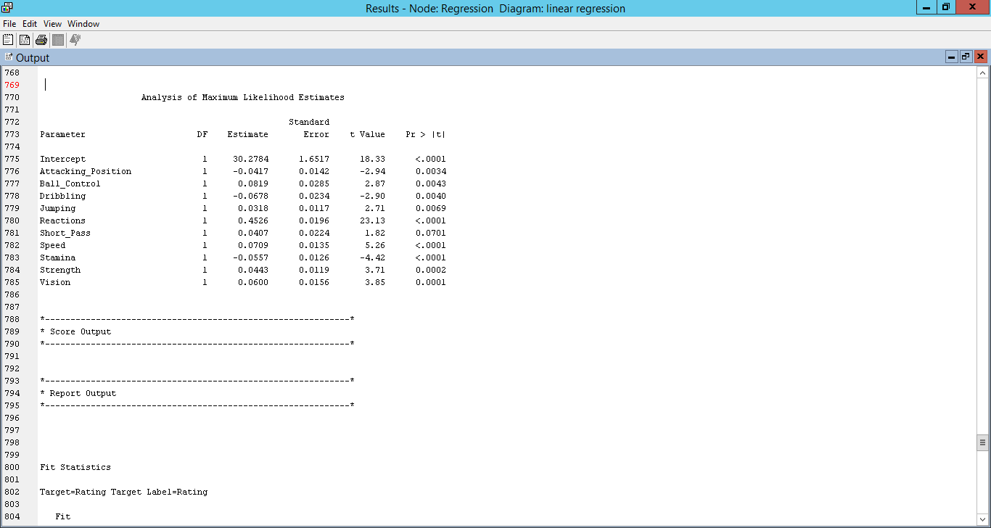
Attackers result

Slide 15
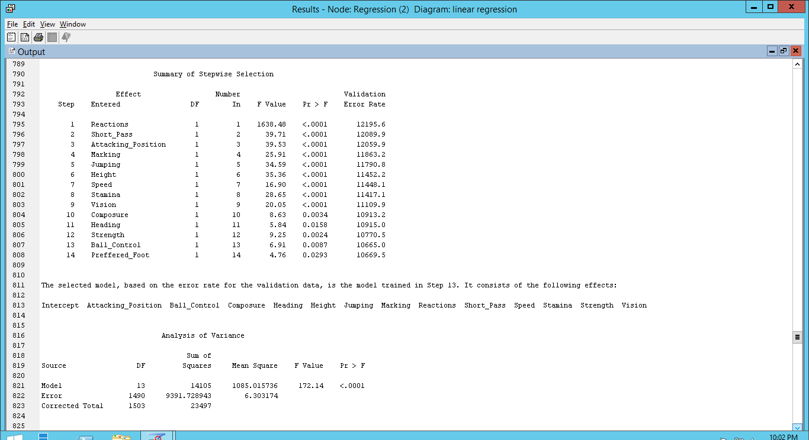
Linear regression – mid fielders
- Applied set wise linear regression
- Following variables were selected statistically: reactions, short pass, jumping, height, stamina, speed, ball control, vision, strength, attacking position, marking, heading

Slide 16
MID fielders result

Slide 17
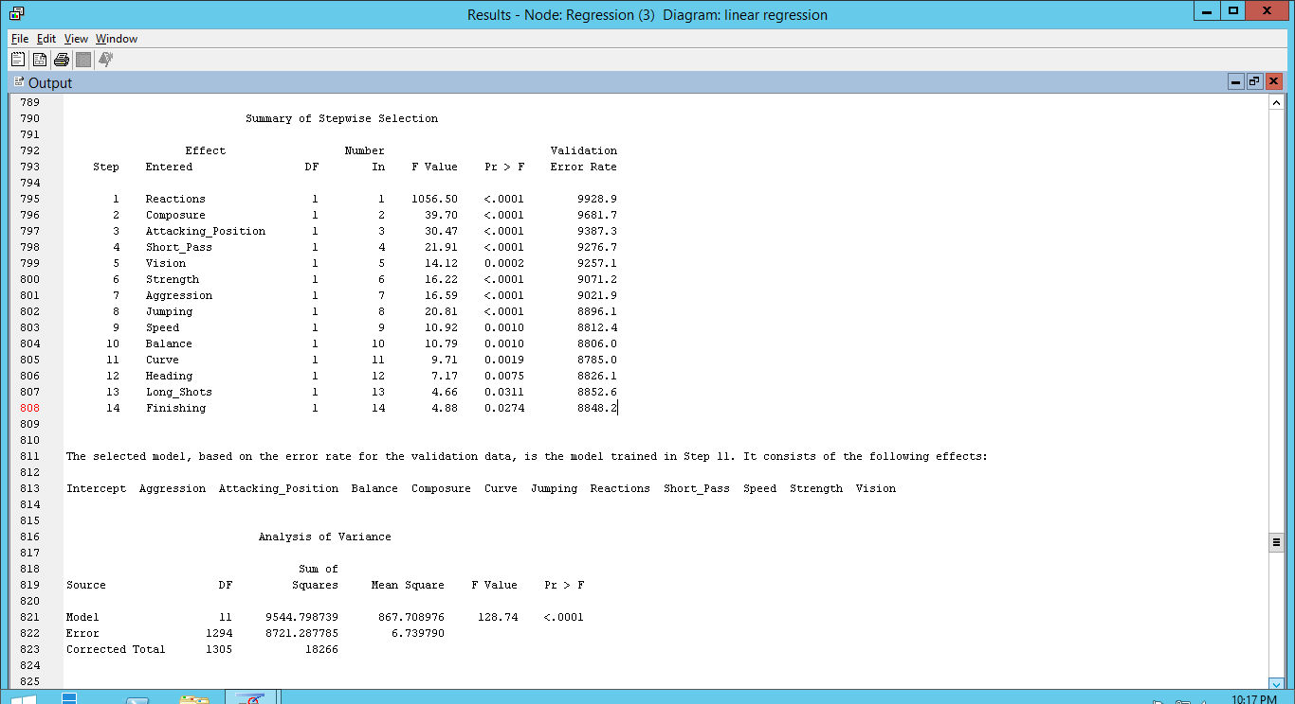
Linear regression – defenders
- Applied set wise linear regression
- Following variables were selected statistically: strength, reactions, aggression, short pass, jumping, speed, vision, strength, attacking position, curve, composure, balance

Slide 18
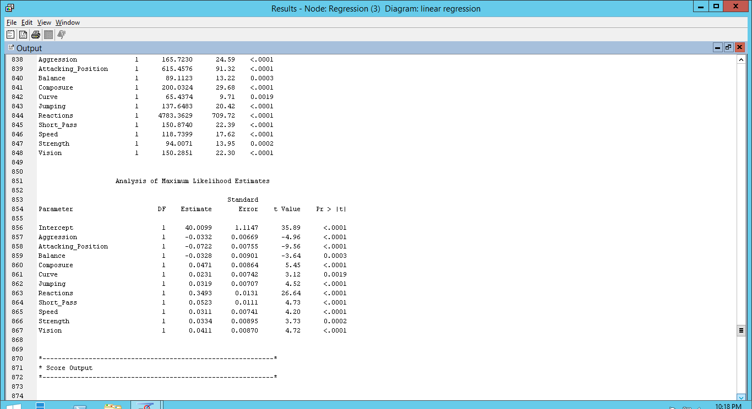
defenders result

Slide 19
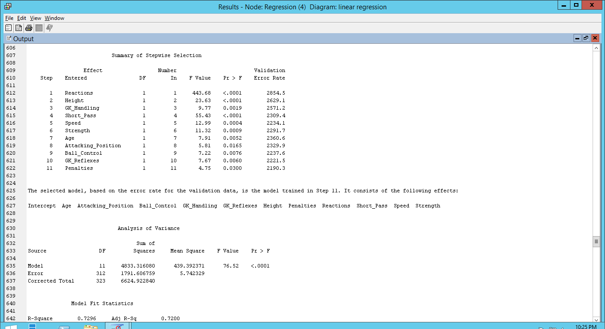
Linear regression – Goal keeper
- Applied set wise linear regression
- Considered following variables GK handling, Reflexes, height, age, reactions, short pass, speed, ball control, strength, attacking position, penalties

Slide 20
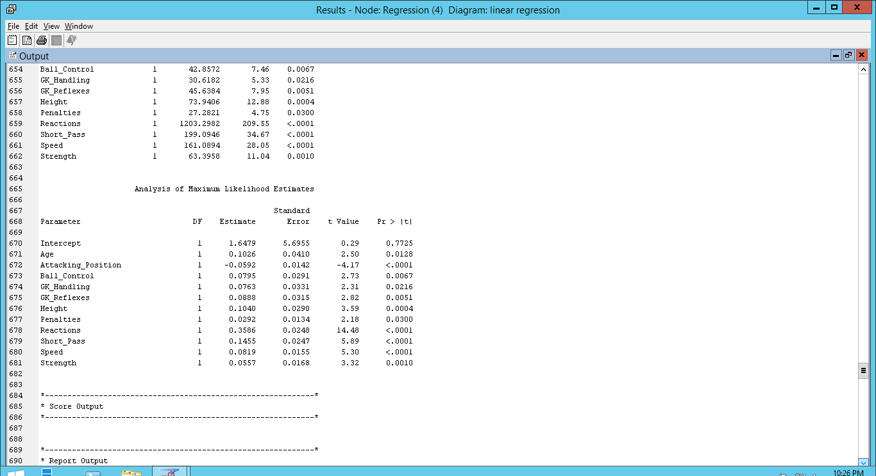
GOAL keeper result

Slide 21
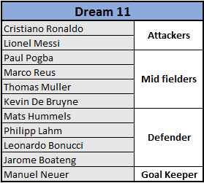
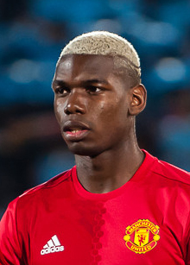


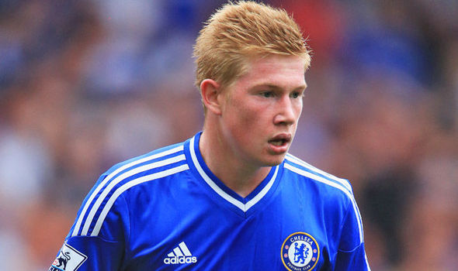

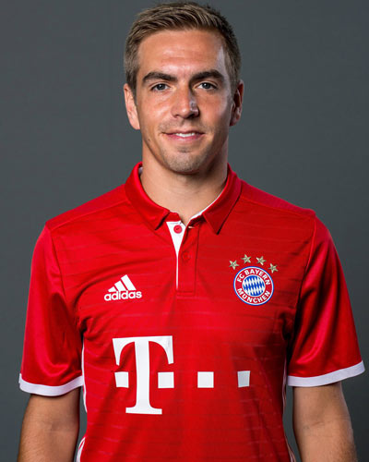



DREAM 11

Slide 22
Descriptive statistics
DECISION TREE
V/S
LOGISTIC REGRESSION
We are Classifying Work Rate into 2 Classes
High and Low
Player’s Work Rate-Attack and Work Rate-Defense is modelled
Identified the most important parameters determining their class
Identified how pure the leaf nodes are
Compared the Tree model with Logistic Regression Model

Slide 23
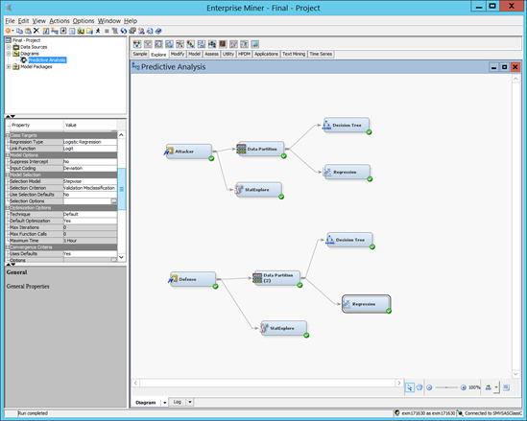

Slide 24
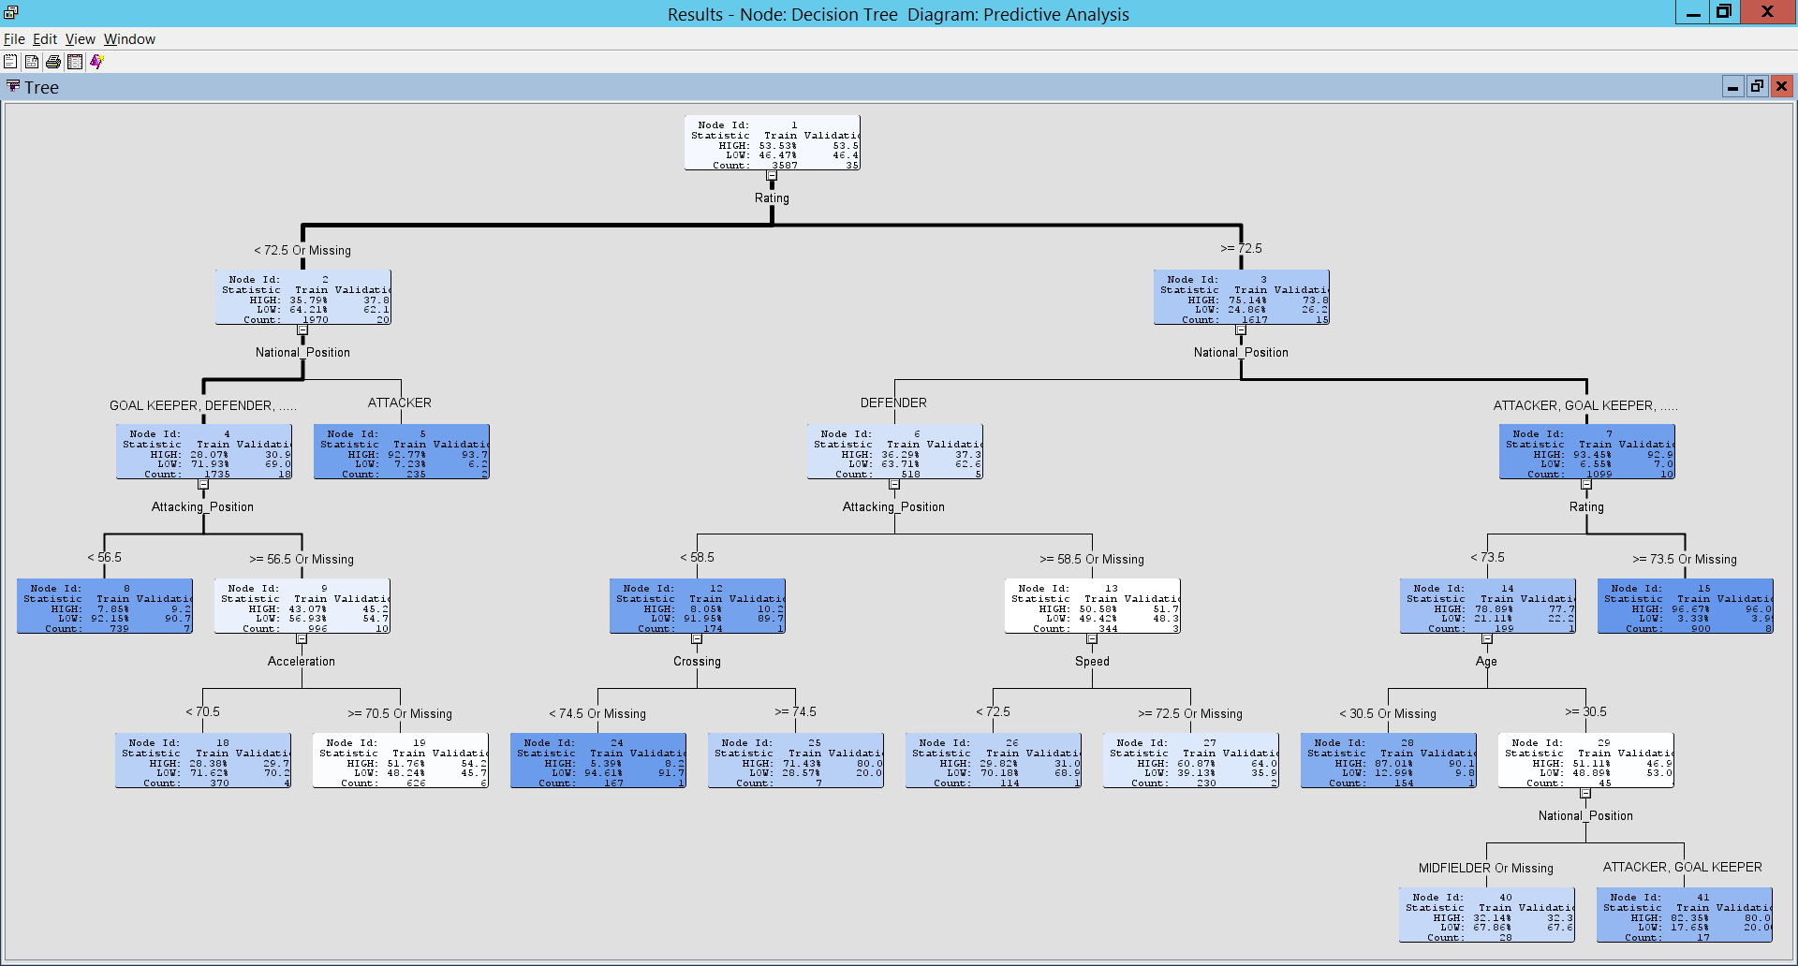
Work Rate-Attack using Tree
-

Slide 25
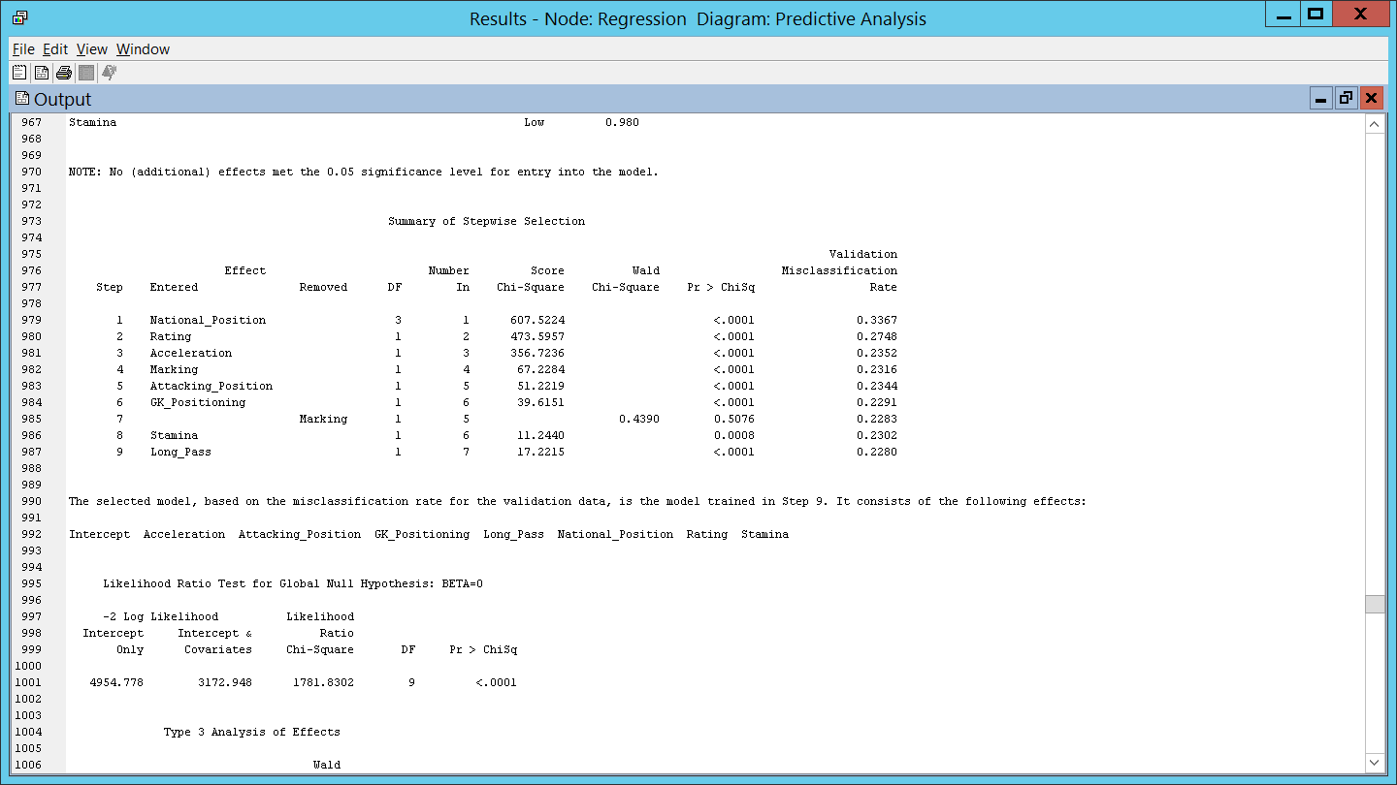
Attack using Logistic Regression
Statistically the Stepwise Regression chose 8 parameters:
National Position, Rating, Acceleration, Marking, Attacking Position, GK, Positioning Stamina, Long Pass

Slide 26
Model Comparison

Slide 27
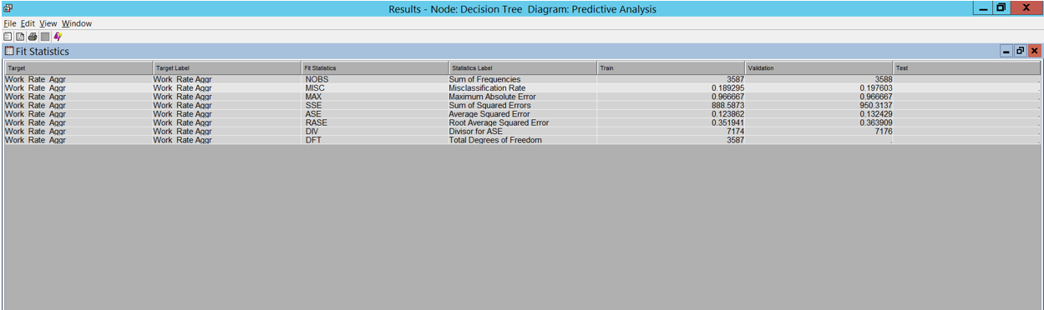
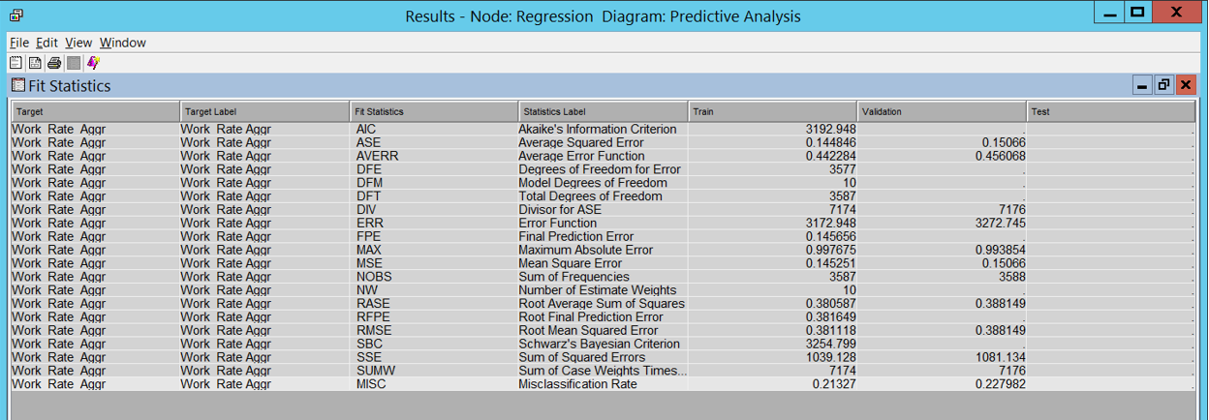
Tree Regression

Slide 28
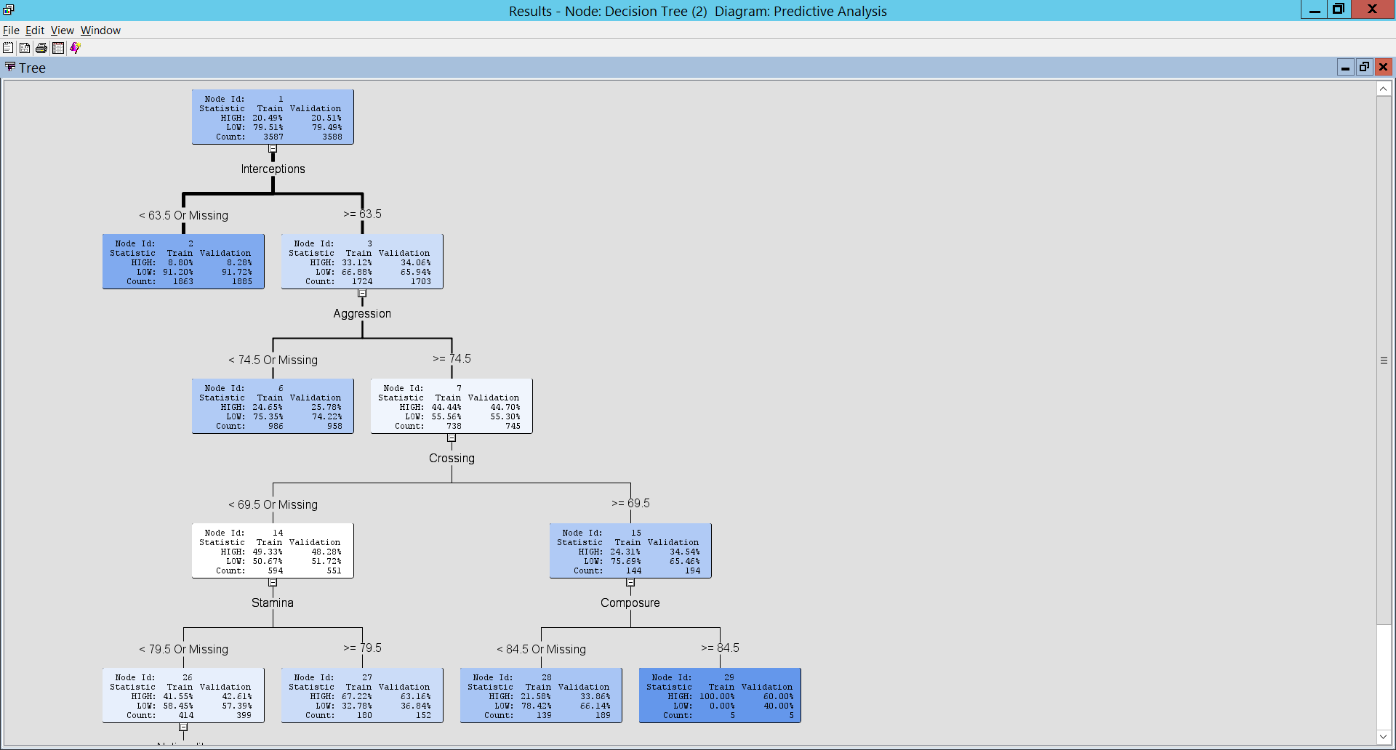
Work Rate-Defense using Tree
-

Slide 29
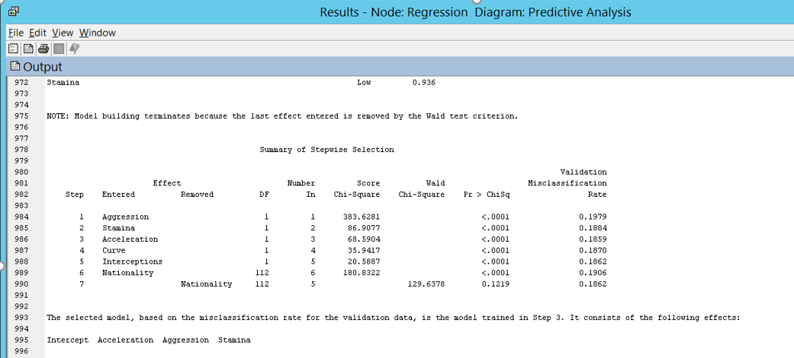
Attack using Logistic Regression
Statistically the Stepwise Regression chose 3 parameters:
Aggression, Stamina,
Acceleration

Slide 30
Model Comparison

Slide 31
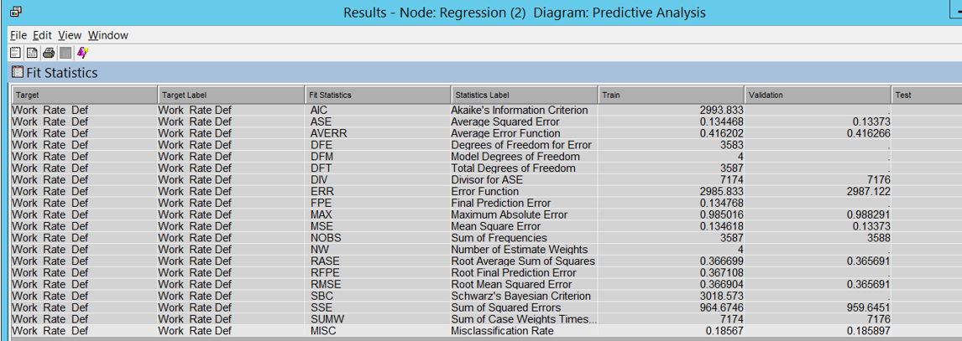
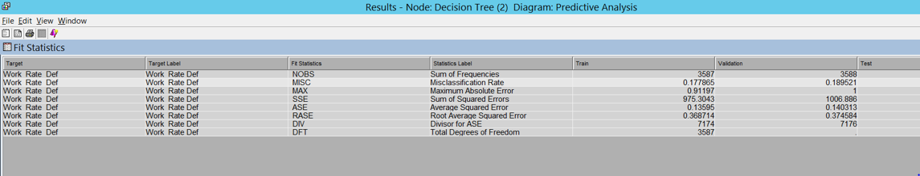
Tree Regression

Slide 32
applications
Submit our analysis report to Electronics Arts (game owners), so that they can use it for developing the future versions of the game. (e.g. FIFA 18, Football Manager)
Soccer Performance Analytics - The analysis can help coaches and managers to quantitatively assess the players leading to improved team performance as well as design a set of winning strategies for the future.
Scouting - The analysis/findings can be submitted to scouts who are looking for potential players to play at positions that any club/country lacks.
Predict the player performances, which can help us in preparing the best teams for online Fantasy Premier League

Slide 33
CONCLUSION
‘Reactions’ matters the most while calculating the rating irrespective of the position of the players
• Brazil, Belgium, France, Germany and Spain have the maximum youngsters which have highest potential
• For attacking work-rate the parameters that matters the most are ‘Rating’, ‘National Position’, ‘Attacking Position’, ‘Acceleration’, ‘Crossing’, ‘Speed’ and ‘Age’
• For defensive work-rate the parameters that matters the most are ‘Interception’, ‘Aggression’, ‘Crossing’, ‘Stamina’, ‘Composure’ and ‘Nationality ’ matters the most

Slide 34


Slide 35
Q&A

